Slide 1
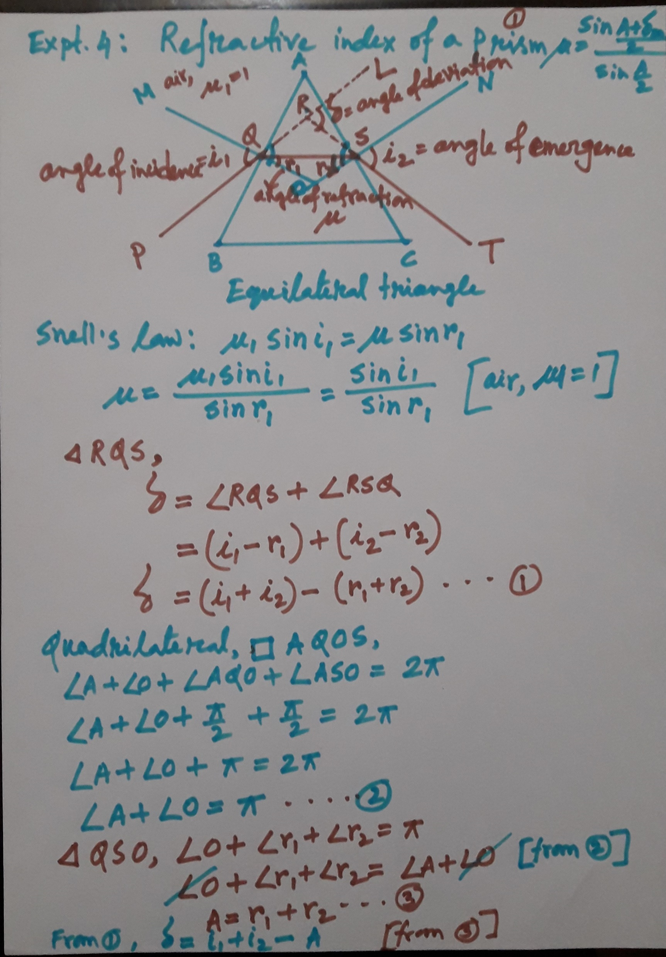

Slide 2
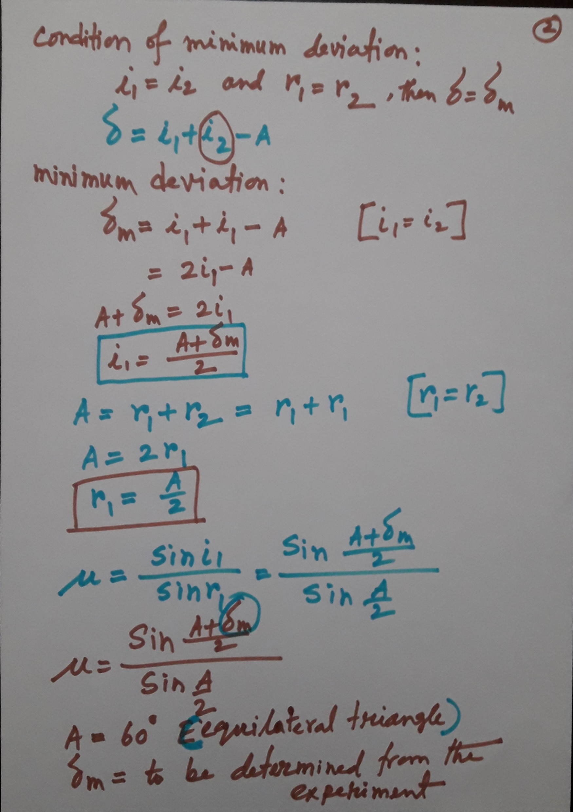

Slide 3
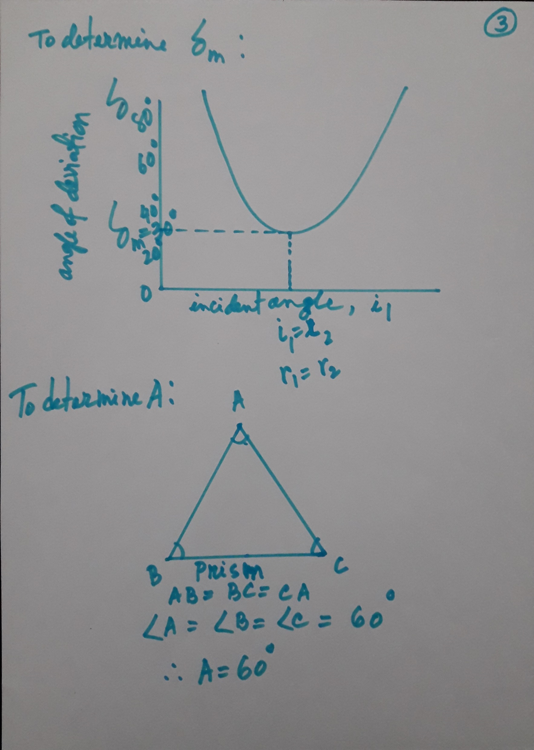

Slide 4
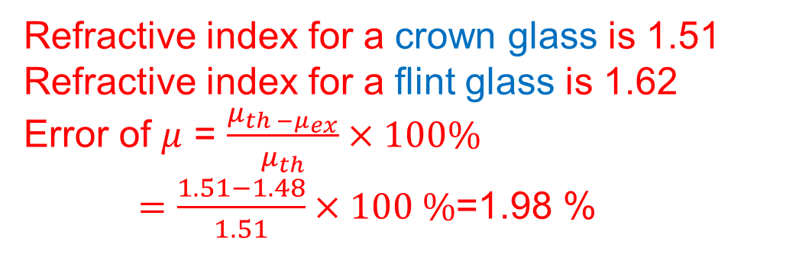
Refractive index for a crown glass is 1.51
Refractive index for a flint glass is 1.62
Error of $μ$ = $\frac{μ_{th −μ_{ex}}}{μ_{th}}×100\%$
$=\frac{1.51−1.48}{1.51}×100 \%$=1.98 %

